Slide 1
Weekly Discovery Report 5
CycleSIGHT
Aiyana, Gloria, Farruh
CycleSIGHT: Because pain isn’t one-size-fits-all.

Slide 2
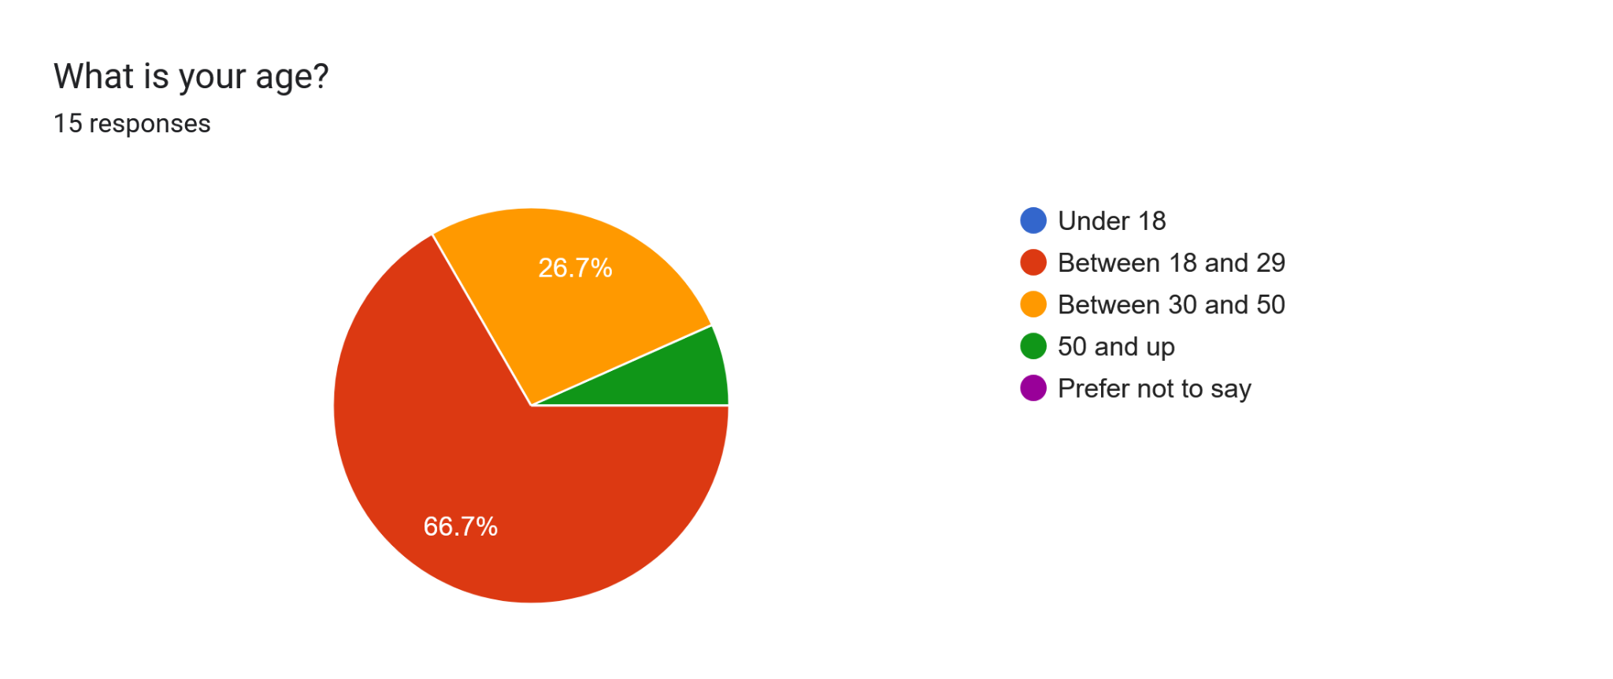
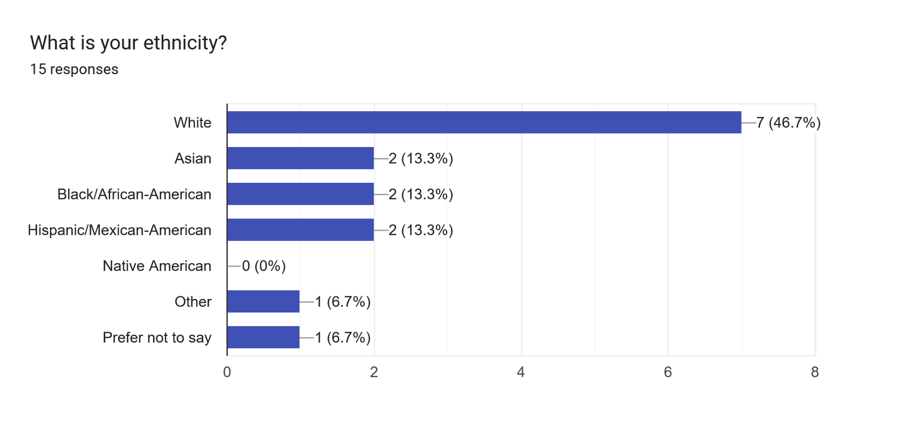
Demographics

Slide 3
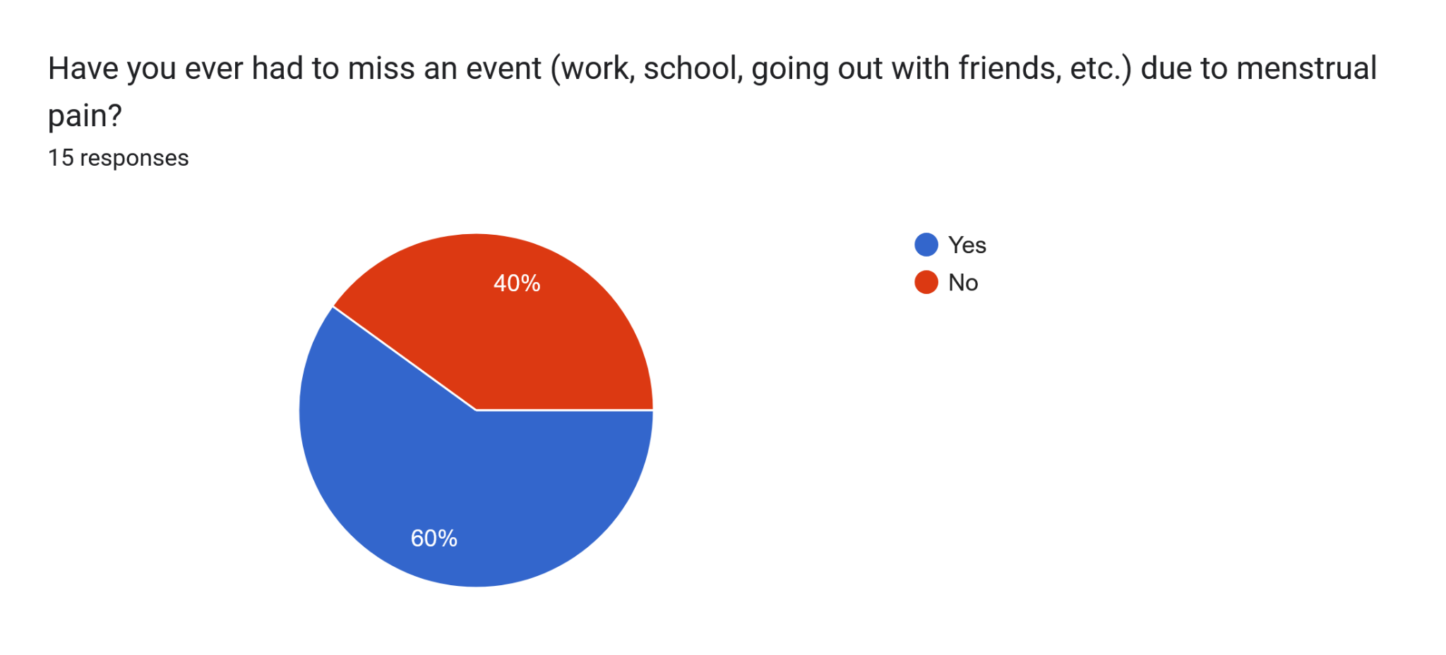
Q1.

Slide 4
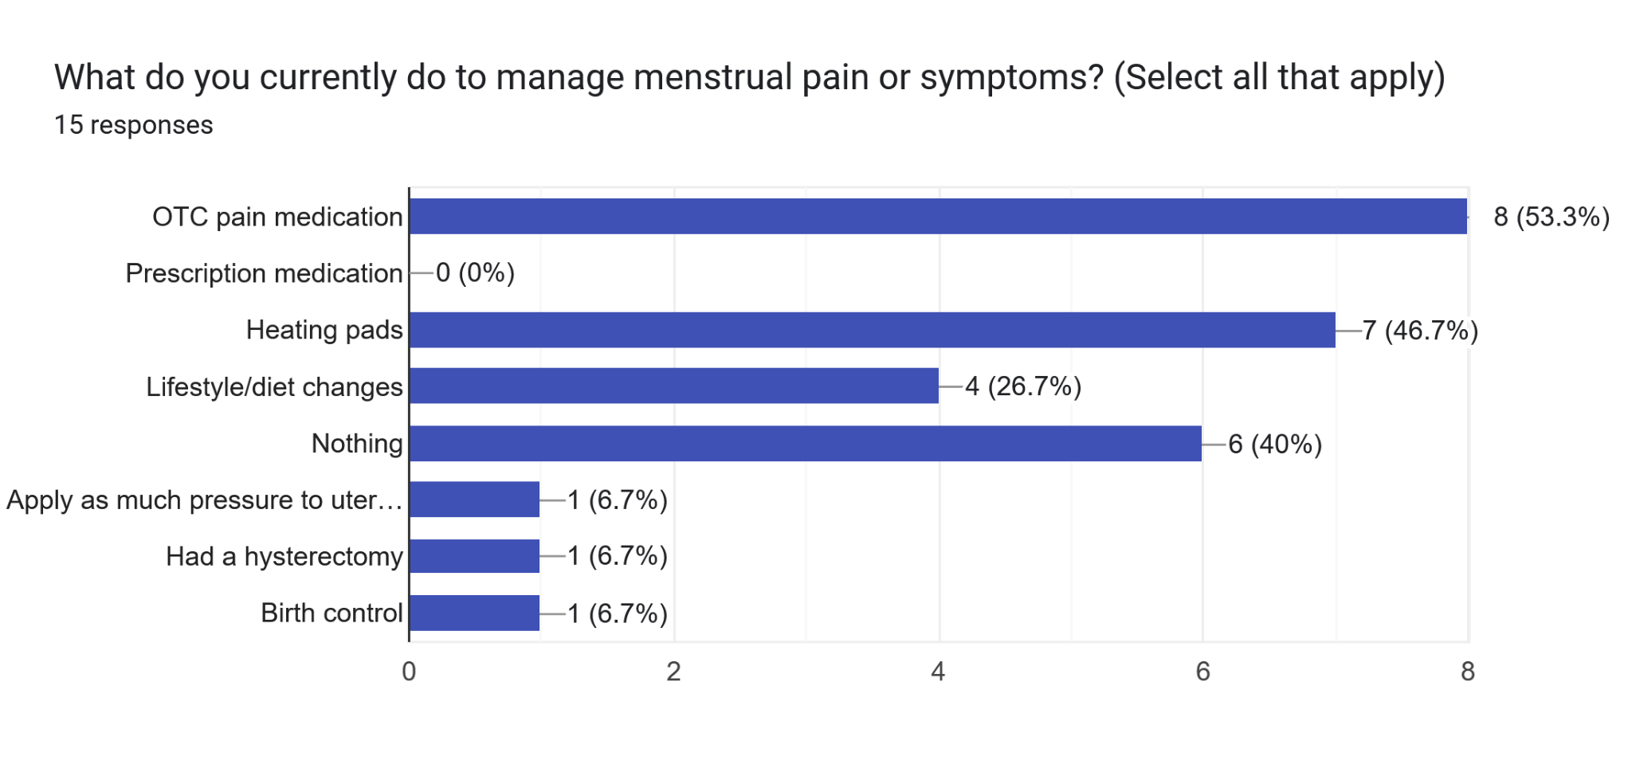
Q2.

Slide 5
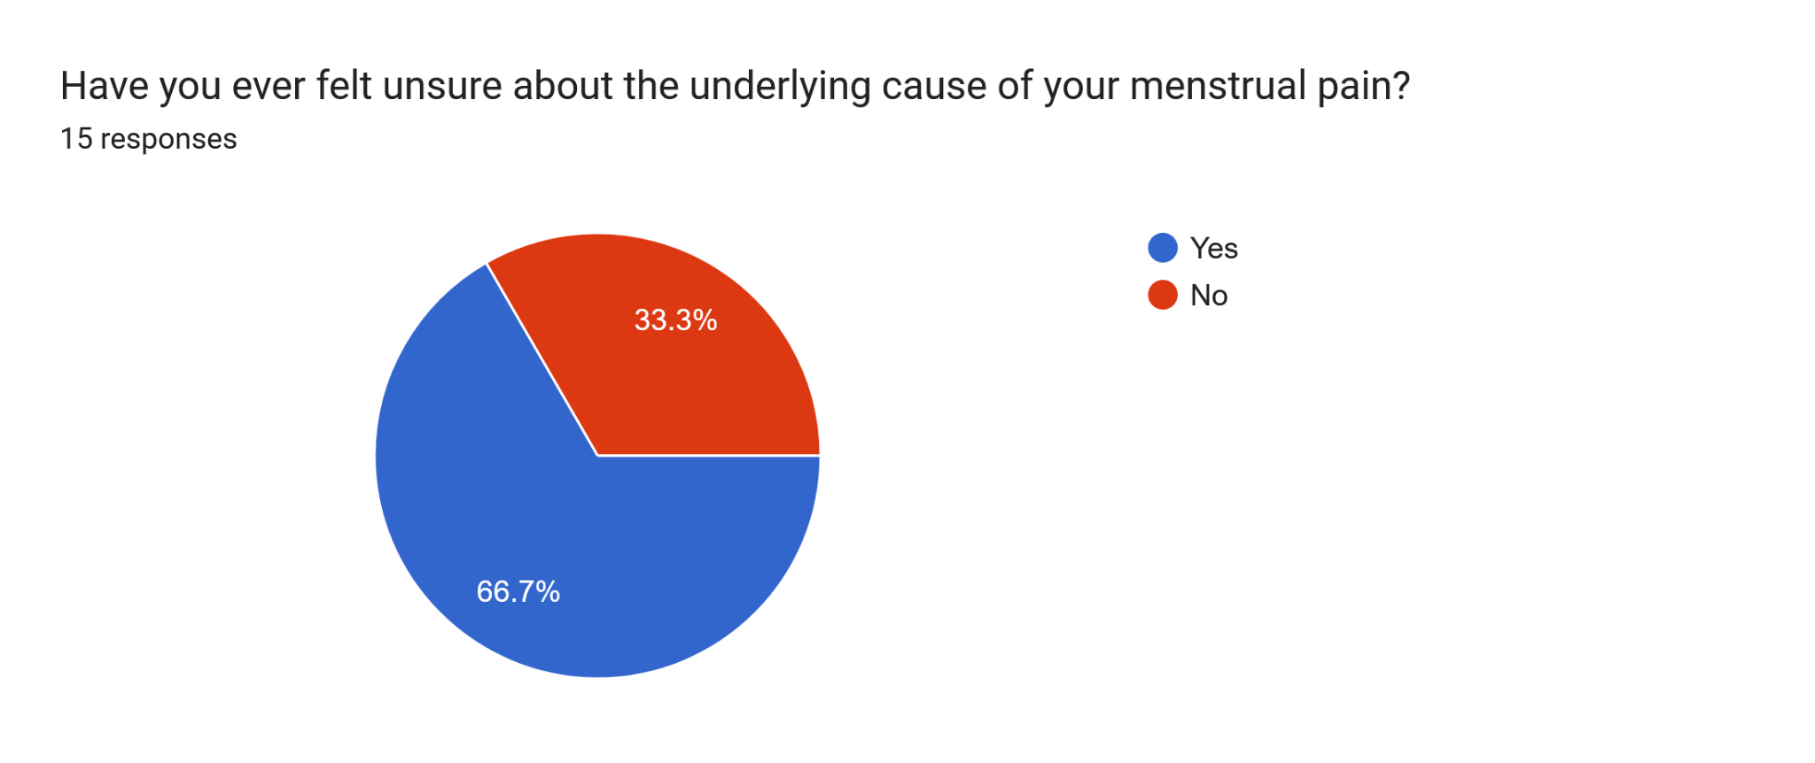
Q3.

Slide 6
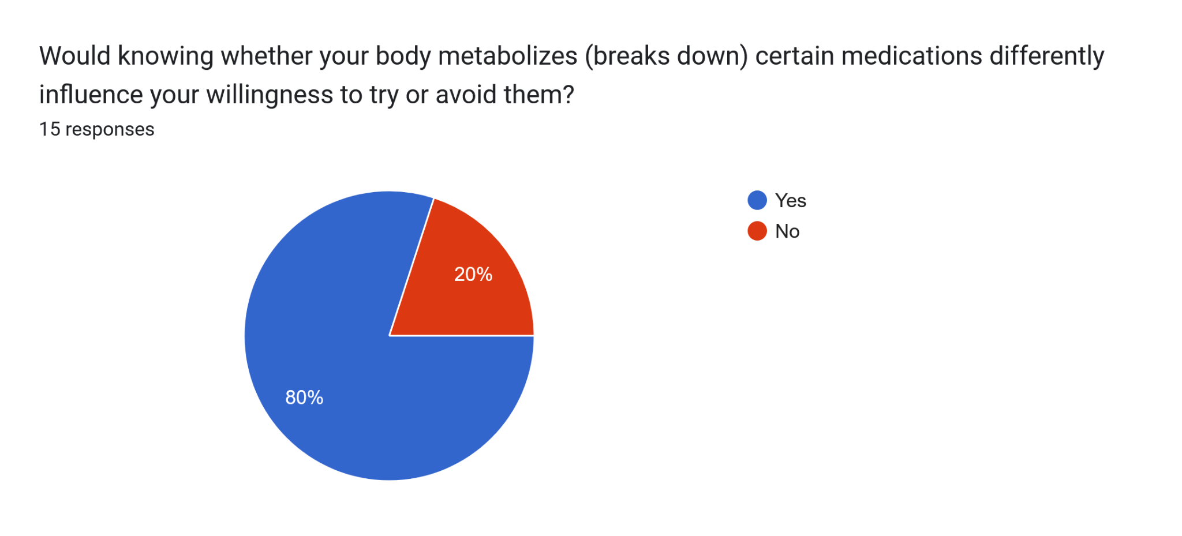
Q4.

Slide 7
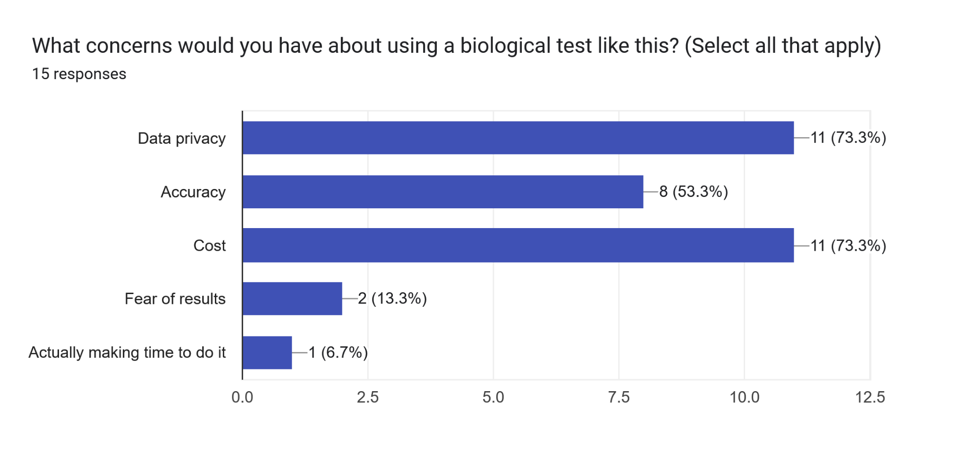
Q5.

